Slide 1
Monetary Policy Committee
Price, Monetary and Balance of Payments Developments
V. Punchoo
Head - Statistics Division
14 July 2014

Slide 2
Inflation Highlights -I
Between March & June 2014, CPI fell by 0.9 index points from 107.7 to 106.8, bringing the y-o-y inflation rate in June 2014 to 3.3 per cent from 4.5 per cent in March 2014. Headline inflation stood at 4.0 per cent for the third month-running
The initial assumption that the impact on the CPI of the supply shock to food on account of adverse climatic conditions in January and February 2014 would gradually fade and market conditions returning back to normal around September has turned out to be incorrect.

Slide 3
Inflation Highlights -II
In fact supply conditions have normalized much faster and by June 2014, the impact of the temporary shock had died out
On the basis of current trends and barring any other shocks, it has become less likely that inflation would reach levels forecast in February and April 2014
The falling inflation in recent months is likely to be explained by tame global commodity prices, stable rupee exchange rates and weak domestic demand conditions mirrored by downward revisions in the growth forecasts

Slide 4
CPI Developments I
Consumer Price Index | Mar-14 | Apr-14 | May-14 | Jun-14 | Cumulative Chg since Mar
Food & Non Alcoholic Beverages | 111.3 | 111.0 | 107.4 | 108.1 | -3.2
Alcoholic Beverages & Tobacco | 116.6 | 116.3 | 116.4 | 116.3 | -0.3
Clothing & Footwear | 109.0 | 109.6 | 110.3 | 109.5 | 0.5
Housing, Water, Electricity, Gas &.. | 101.3 | 101.3 | 101.4 | 101.3 | 0.0
Furnishings, Household Equipment & Routine Household Equipment | 102.8 | 102.9 | 102.9 | 102.7 | -0.1
Health | 108.4 | 108.8 | 108.8 | 108.8 | 0.4
Transport | 105.9 | 105.9 | 105.8 | 105.3 | -0.6
Communication | 99.9 | 99.9 | 99.8 | 99.8 | -0.1
Recreation & Culture | 104.8 | 106.2 | 106.2 | 105.8 | 1.0
Education | 103.3 | 103.3 | 103.3 | 103.3 | 0.0
Restaurants & Hotels | 111.3 | 111.0 | 111.2 | 111.6 | 0.3
Misc. Goods & Services | 104.7 | 105.0 | 104.9 | 105.3 | 0.6
Overall | 107.7 | 107.7 | 106.8 | 106.8

Slide 5
CPI Developments II
Consumer Price Index |  |  |  |  | Weighted Contribution to inflation %
DIVISIONS | Weights | Jun-13 | Mar-14 | Jun-14 | Mar-14 to Jun-14 | Jun-13 to Jun-14
Food & Non Alcoholic Beverages | 273 | 103.9 | 111.3 | 108.1 | -0.8 | 1.1
Fresh Vegetables | 39 | 109.3 | 147.3 | 115.0 | -0.9 | 0.2
Alcoholic Beverages & Tobacco | 96 | 109.9 | 116.6 | 116.3 | 0.0 | 0.6
Clothing & Footwear | 45 | 102.7 | 109.0 | 109.5 | 0.0 | 0.3
Housing, Water, Electricity, Gas & | 120 | 100.3 | 101.3 | 101.3 | 0.0 | 0.1
Furnishings, Household Equipment | 61 | 102.6 | 102.8 | 102.7 | 0.0 | 0.0
Health | 40 | 103.9 | 108.4 | 108.8 | 0.0 | 0.2
Transport | 151 | 103.1 | 105.9 | 105.3 | -0.1 | 0.3
Communication | 39 | 100.1 | 99.9 | 99.8 | 0.0 | 0.0
Recreation & Culture | 44 | 99.2 | 104.8 | 105.8 | 0.0 | 0.3
Education | 45 | 101.7 | 103.3 | 103.3 | 0.0 | 0.1
Restaurants & Hotels | 45 | 106.4 | 111.3 | 111.6 | 0.0 | 0.2
Misc. Goods & Services | 41 | 102.4 | 104.7 | 105.3 | 0.0 | 0.1
Overall | 1000 | 103.4 | 107.7 | 106.8 | -0.8 | 3.3

Slide 6
CPI Developments III Recomputing CPI without the temporary shock
Consumer Price Index | Mar-14 | Apr-14 | May-14 | June-14
Food & Non Alcoholic Beverages | 105.3 | 106.3 | 106.4 | 106.9
Alcoholic Beverages & Tobacco | 116.6 | 116.3 | 116.4 | 116.3
Clothing & Footwear | 109.0 | 109.6 | 110.3 | 109.5
Housing, Water, Electricity, Gas &.. | 101.3 | 101.3 | 101.4 | 101.3
Furnishings, Household Equipment & Routine Household Equipment | 102.8 | 102.9 | 102.9 | 102.7
Health | 108.4 | 108.8 | 108.8 | 108.8
Transport | 105.9 | 105.9 | 105.8 | 105.3
Communication | 99.9 | 99.9 | 99.8 | 99.8
Recreation & Culture | 104.8 | 106.2 | 106.2 | 105.8
Education | 103.3 | 103.3 | 103.3 | 103.3
Restaurants & Hotels | 111.3 | 111.0 | 111.2 | 111.6
Misc. Goods & Services | 104.7 | 105.0 | 104.9 | 105.3
Overall | 106.1 | 106.4 | 106.5 | 106.5

Slide 7
Inflation Indicators
Moderate underlying inflationary pressures - Y-o-y CORE1 stood unchanged at 2.7% in June 2014, compared to March 2014 while CORE2 inflation edged up from 3.1% in March 2014 to 3.2% in June 2014
Y-o-Y imported CPI inflation rose from 3.1% in March 2014 to 3.5% in May 2014 before easing to 3.4% in June 2014.
Y-o-Y goods inflation went down from 5.2% in Mar 2014 to 3.3% in Jun 2014 while services inflation remained unchanged at 3.2% in June 2014.

Slide 8
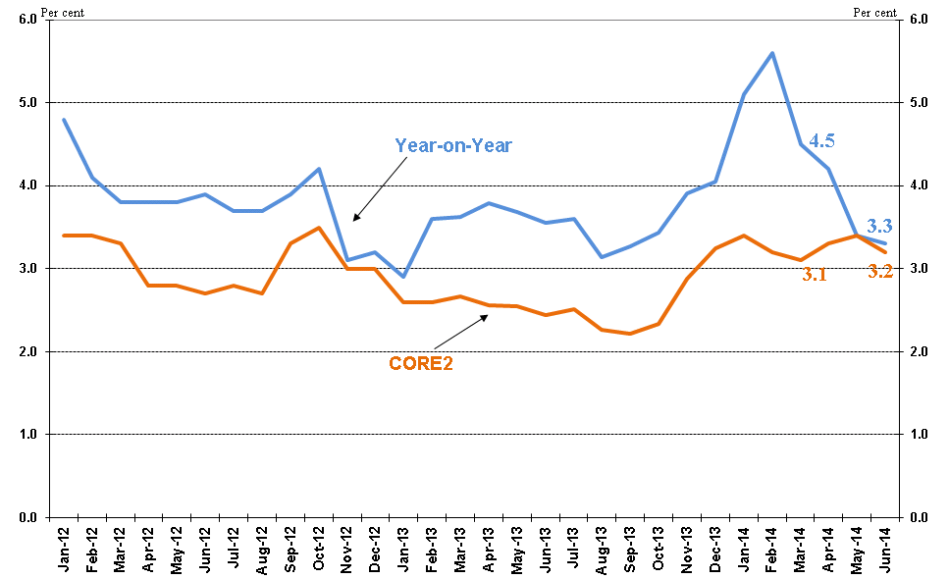
Year-on-Year and CORE2

Slide 9
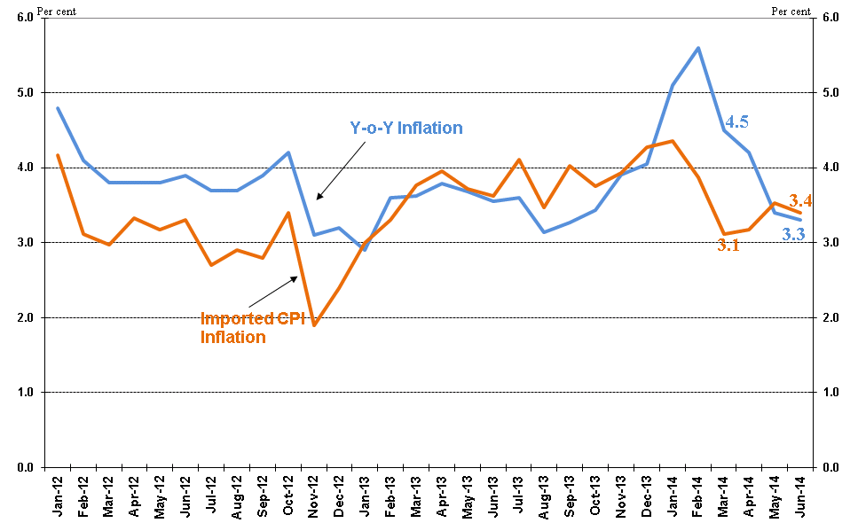
Y-o-Y Inflation & Imported Component

Slide 10
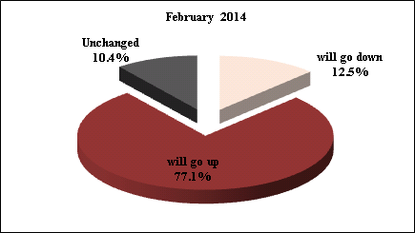
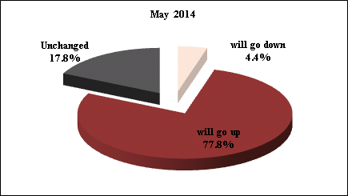
Price Expectations a year ahead

Slide 11
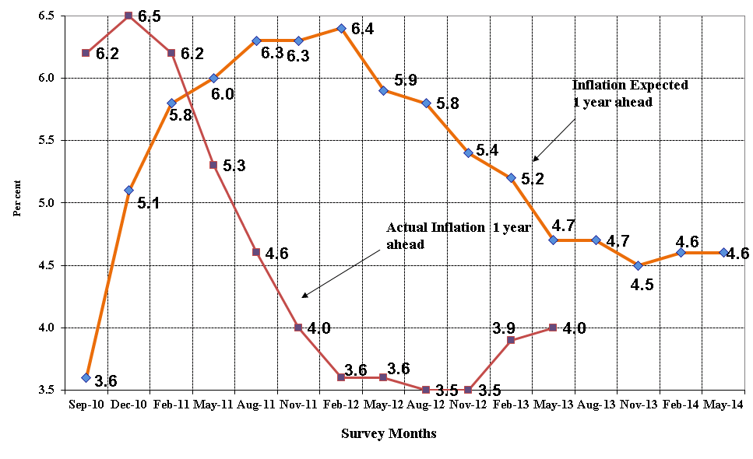
Inflation Expectations Mean-trend - A year ahead

Slide 12
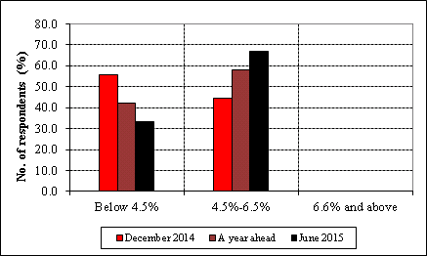
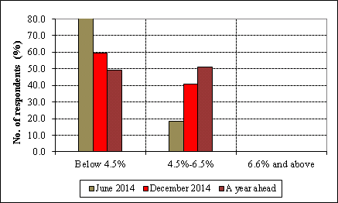
Mean Expectations – Time Horizons
IES – May 2014
IES – February 2014

Slide 13
MONETARY DEVELOPMENTS

Slide 14
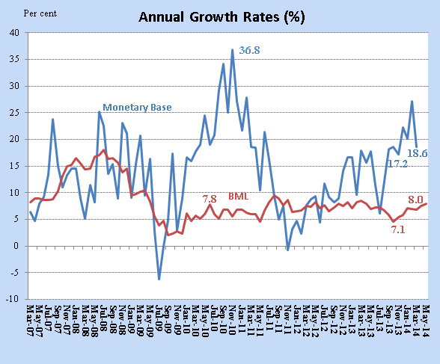
Monetary Developments – I

Slide 15
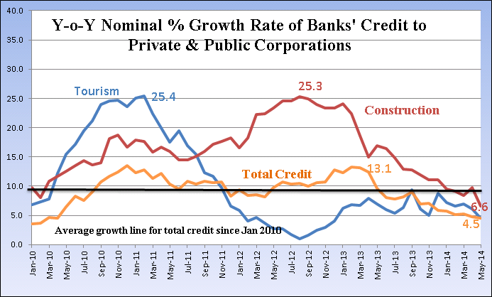
Monetary Developments - III

Slide 16
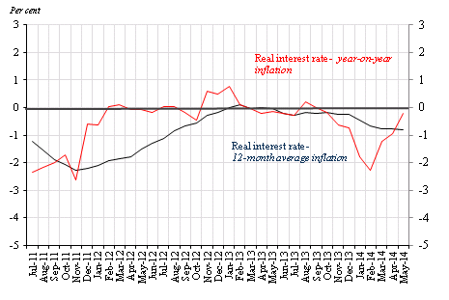
Interest Rate Developments
Real interest rate is based on weighted savings deposit rates and does not take into account the drop in savings interest rates by some banks.

Slide 17
BALANCE OF PAYMENTS DEVELOPMENTS

Slide 18
Merchandise Trade & Current Account Deficits Ratio

Slide 19
Summary BOP I
Rs Million | Q1-2011 | Q1-2012 | Q1-2013 | Q1-2014
Current Account (Including GBC1s) | -5,706 | -2,988 | -7,301 | -5,379
Current Account (Excluding GBC1s) | -4,301 | -5,897 | -8,165 | -5,702
Exports (f.o.b) | 16,986 | 17,997 | 20,361 | 21,385
Imports (f.ob) | -32,932 | -35,631 | -36,000 | -34,038
Trade balance | -15,953 | -17,634 | -15,639 | -12,653
Services, net | 8,247 | 9,631 | 6,130 | 4,587
o.w travel, net | 9,137 | 11,193 | 8,852 | 7,914
Income, net (Including GBC1s) | 748 | 3,438 | 2,115 | 2,217
Income, net (Excluding GBC1s) | 2,086 | 394 | 1,168 | 1,839
Current transfers, net | 1,252 | 1,577 | 93 | 470
Current A/c (Incl. GBC1s) as a % of GDP_{mp} | -7.6 | -3.8 | -8.6 | -6.1
Current A/c (Excl. GBC1s) as a % of GDP_{mp} | -5.7 | -7.4 | -9.7 | -6.5

Slide 20
Summary BOP II
Rs million | Q1-2011 | Q1-2012 | Q1-2013 | Q1-2014
Capital & Financial Account | 4,472 | -9,827 | 8,233 | 7,646
Direct investment, net (Including GBC1s) | 1,282 | 53,795 | 15,194 | 6,508
Direct investment, net (Excluding GBC1s) | 1,799 | 1,787 | 1,586 | 1,508
Abroad (Excluding GBC1s) | -1,069 | -1,346 | -612 | -75
In Mauritius (Excluding GBC1s) | 2,868 | 3,133 | 2,198 | 1,583
Portfolio investment, net (Including GBC1s) | 52,303 | 9,549 | 18,573 | 10,561
Portfolio investment, net (Excluding GBC1s) | -1,244 | -547 | 1,813 | 1,061
Equity (Excluding GBC1s) | -1,226 | -607 | 1,988 | 882
Debt (Excluding GBC1s) | -18 | 60 | -175 | 179
Other investment, net (Including GBC1s) | -47,307 | -74,744 | -20,523 | -3,313
Other investment, net (Excluding GBC1s) | -6,841 | -33,879 | 14,022 | 34,887
General Government | 3,723 | 76 | 922 | 1,767
Monetary Authorities | 0 | 0 | 0 | 0
Banks | -12,221 | -33,729 | 11,521 | 30,933
Other Sectors: Long-term (Excluding GBC1s) | 390 | -1,187 | -613 | -732
Other Sectors: Short-term | 1,267 | 961 | 2,192 | 2,919
Balance of payments Surplus (-)/ Deficit (+) | -1,797 | 1,614 | -5,004 | -6,090

Slide 21
Net Invisibles

Slide 22
Reserves Adequacy

Slide 23
Thank you

